Slide 1
The Four Components of a Good Language Class
Dr. Jan Dormer
Messiah College
jdormer@messiah.edu

Slide 2
The Four Components

Slide 3
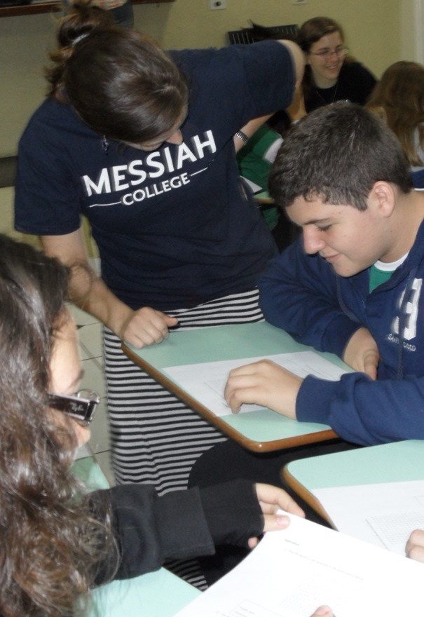
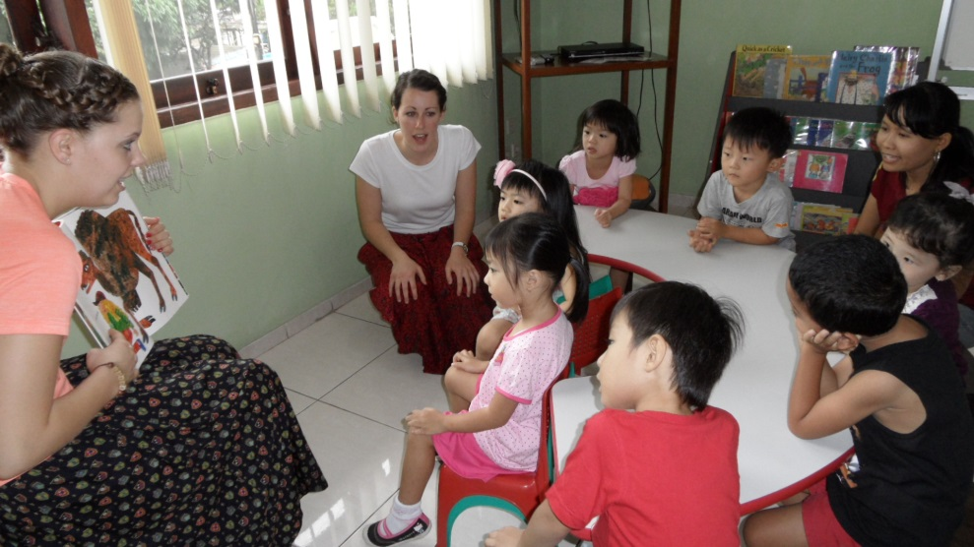
INPUT Students read and listen.
1. Comprehensible: i + 1
2. Meaningful: interesting and motivating
3. Authentic: real communication
4. 5% new words and structures

Slide 4
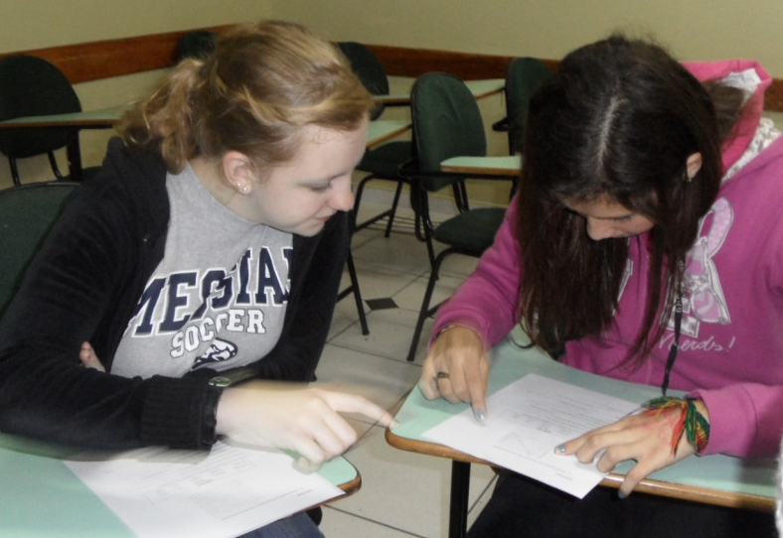
OUTPUT Students speak and write.
1. Appropriate expectations: length, accuracy, discourse
2. Low affective filter: pairs and groups;
group to individual response
3. Authentic: fostering real communication
4. 5% new words and structures

Slide 5
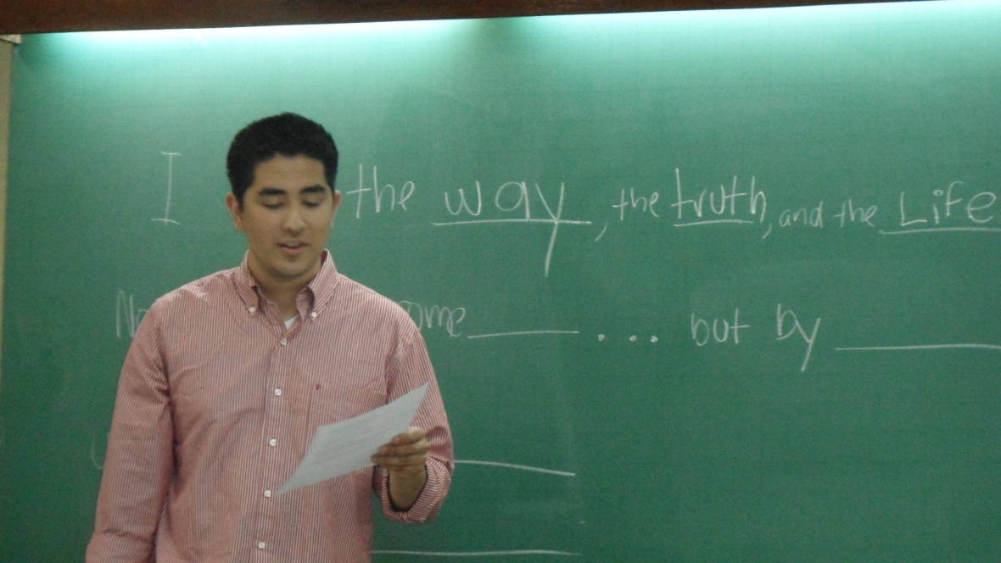
FLUENCY Students develop ease in speaking, listening, reading and writing, with known words.
1. Repetition that is meaningful.
2. 0% new words.
2. Authentic:
useful in real
communication
3. Can use songs
and games.

Slide 6
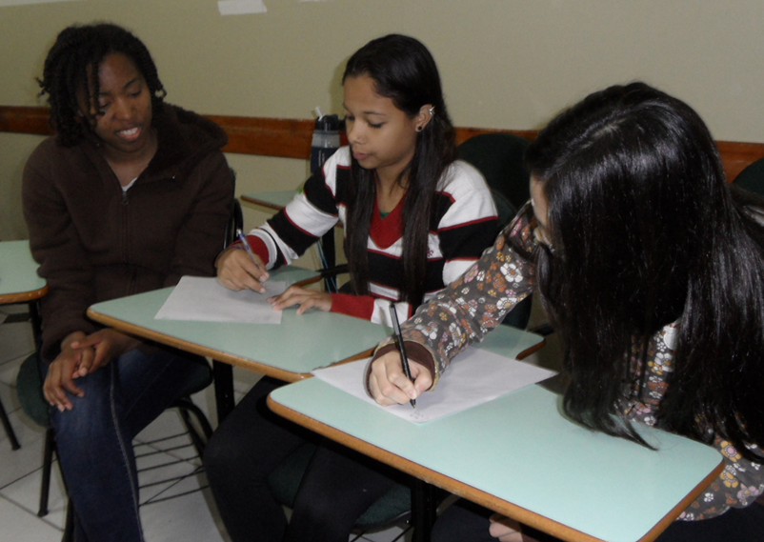
LANGUAGE FOCUS Students study grammar, vocabulary and pronunciation.
1. Build understanding.
2. Focus on form: mini-lessons on words, structures and pronunciation as needed.
3. Within the context of
real communication
4. Should derive from
curriculum rather than being
the source of the curriculum.

